Slide 1

Tomosynthesis Machine Learning
Yanbin Lu

Slide 2
Outline
Background
Breast Imaging Lesion
Our Data
Toy Demo
Tips

Slide 3
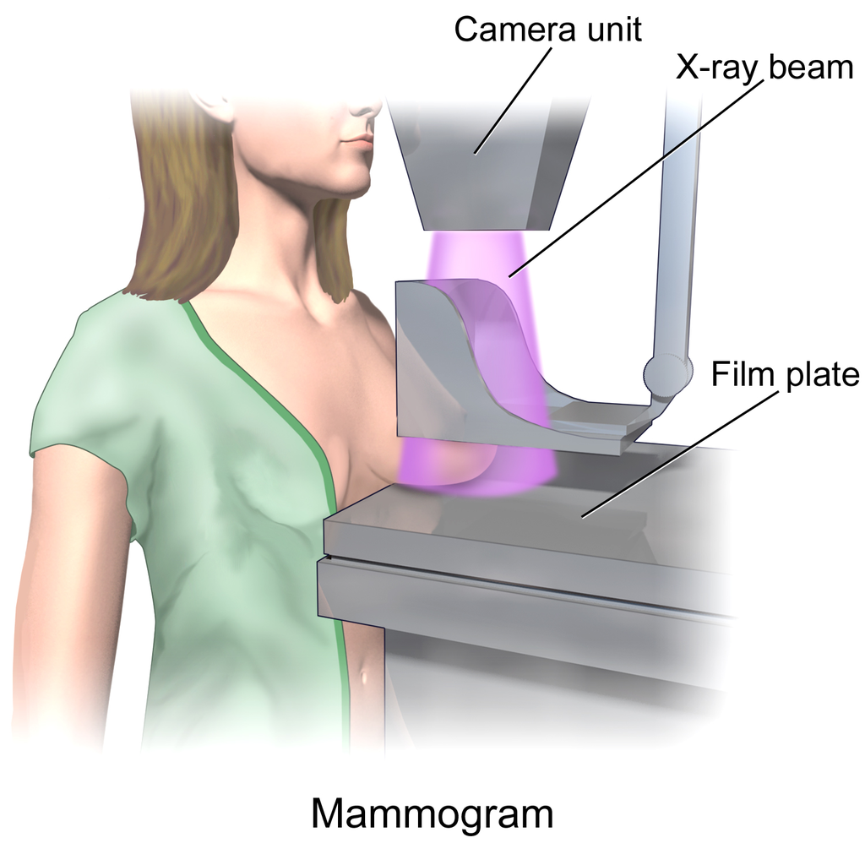
Background
Mammography
Method: Low energy X-ray
Goal: Detection of masses/calcification
Compression of breast
Overlapping of tissue
2D image
http://en.wikipedia.org/wiki/Mammography

Slide 4
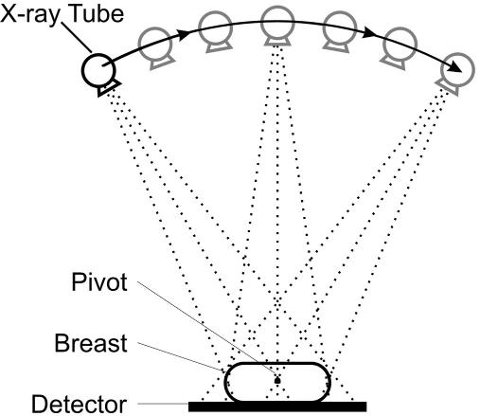
Background
Tomosynthesis
Method: Rotating low energy X-ray
Goal: Detection of masses/calcification
Less compression of breast
3D rendering from different angles
Yaffe Breast Cancer Research 2008 10:209 doi:10.1186/bcr2102

Slide 5
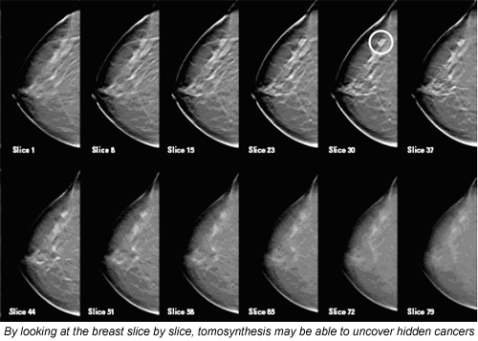
Background
Tomosynthesis
By R Schulz-Wendtland, Erlangen University Hospital, Radiology Institute; T Wacker, Erlangen-Nurnberg University,
and K-P Hermann, Department for Diagnostic Radiology, Gottingen University Hospital

Slide 6
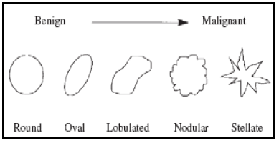
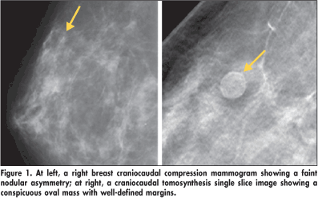
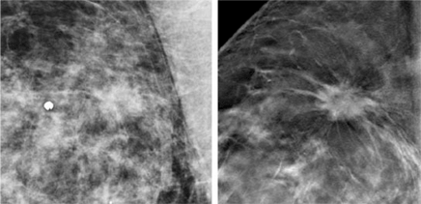
Breast Imaging Lesion
Masses
Three-dimensional structure
Convex outward borders
Circumscribed → Speculated
L.M. Bruce, R.R. Adhami: "Classifying Mammographic Mass Shapes Using the Wavelet Transform Modulus-Maxima Method“,1999.
Jeong Mi Park, MD, Breast Tomosynthesis: How I Read It, Nov 28, 2011
3D Digital Breast Tomosynthesis Provides Clearer Picture of Breast Anatomy Than Does Standard Mammography.

Slide 7
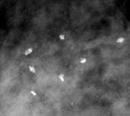
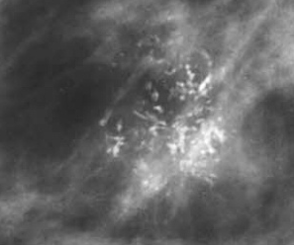
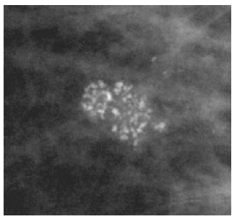
Breast Imaging Lesion
Calcification
Course heterogeneous
Fine pleomorphic (< 0.5mm)
Benign: large, randomly spread
Malignant : clustered, irregular shape
M. Heath, et al.: "The Digital Database for Screening Mammography“, 2000.

Slide 8
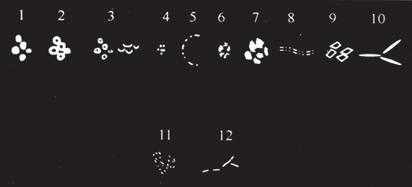
This figure, while by no means an atlas, does give the sense of different calcification configurations
Figure 13-107 This schematic represents many of the types of calcifications that can be seen by mammography: (1) calcified debris in ducts; (2) dense, lucent-centered calcifications in fat necrosis; (3) precipitated calcifications in small cysts (milk of calcium); (4) concretions in small, cystically dilated lobules; (5) rim calcifications in the wall of a cyst; (6) early deposits in an involuting fibroadenoma; (7) large deposits in an involuting fibroadenoma; (8) vascular calcifications; (9) skin calcifications; (10) calcified rods in secretory disease; (11) pleomorphic deposits in intraductal cancer; and (12) fine linear calcifications found in comedocarcinoma.

Slide 9
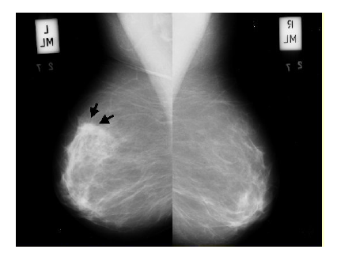
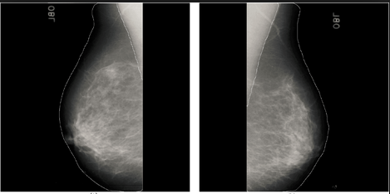
Breast Imaging Lesion
Bilateral Asymmetry

Slide 10
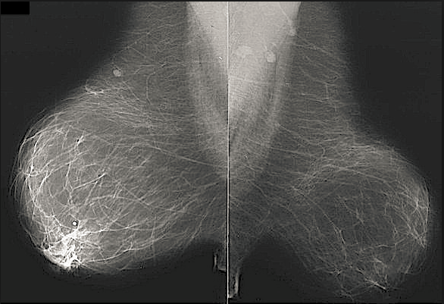
Breast Imaging Lesion
Architectural Distortion
Normal breast is oriented textured converged to the nipple,
Due to the presence of ligament, duct, and vessels
Approaches:
Gabor Filter
Fractal Dimension
Concentration Index
Phase Portrait Modeling
Wavelet/Curvelet
R.M. Rangayyan, F.J. Ayres, J.E.L. Desautels:"A Review of Computer-Aided Diagnosis of Breast Cancer: Toward the Detection of Subtle Signs"

Slide 11
Our Data
Description:
Format: ‘***.smv’
View tool: DualViewerApp.exe (Run in Administrative mode)
Path: /home/yanbin/Tomosynthesis/code
main.py:
dataPath = '/home/yanbin/Tomosynthesis/data/5110/'
outputPath = '/home/yanbin/Tomosynthesis/test/'
fileName = '5110recon08.smv_AutoCrop.smv'
im = ImageIO.imReader(dataPath,fileName, 'smv')
ImageIO.imWriter(outputPath ,'5110.tif',im,3/2)
Convert to : ‘***.tif’
View tool: Fiji

Slide 12
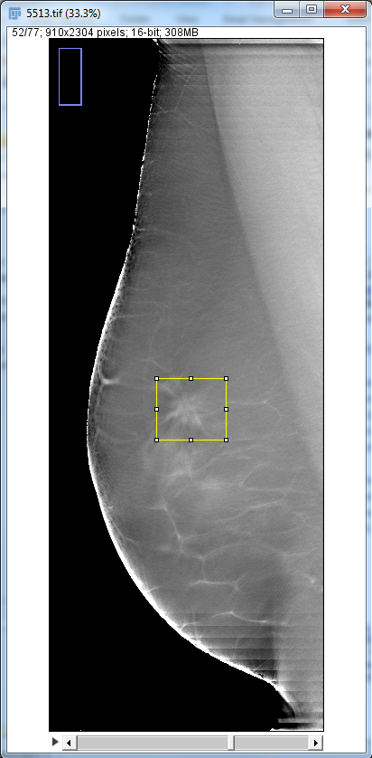
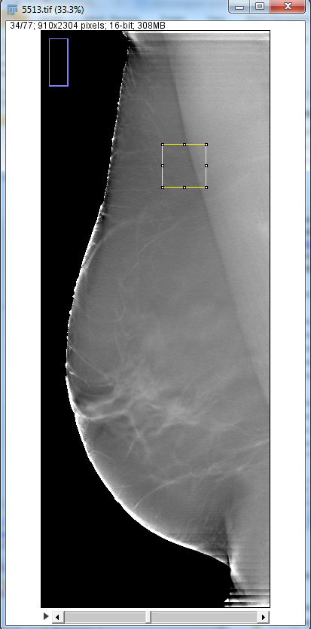
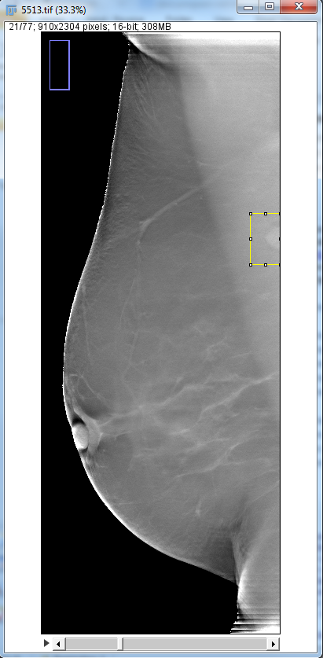
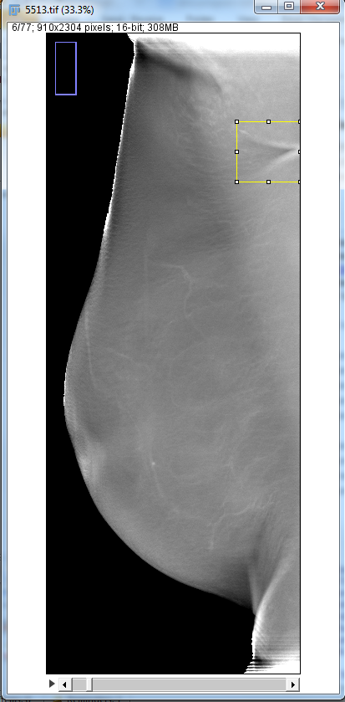
Our Data
Ignore this one
Our Data
skin fold
questionable area
lesion
benign lymph

Slide 13
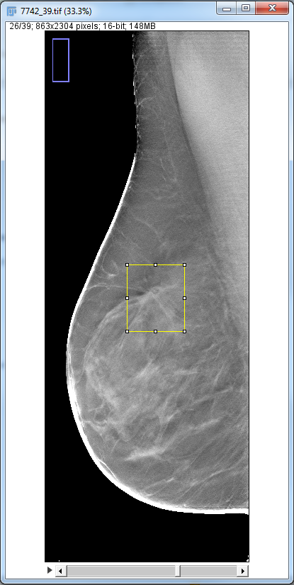
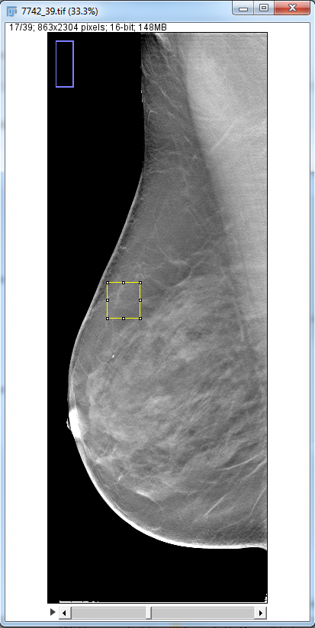
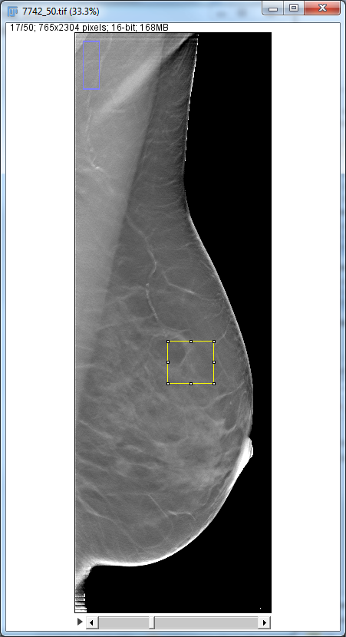
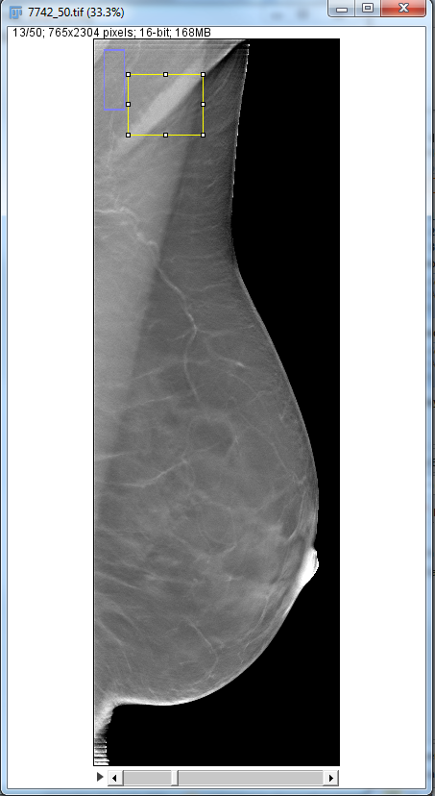
Our Data
Ignore this one
skin fold
lesion
arterial vascular
calcifications
questionable

Slide 14
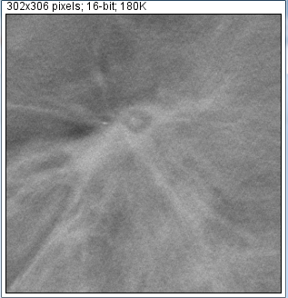
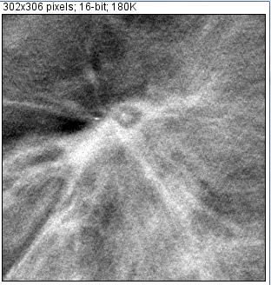
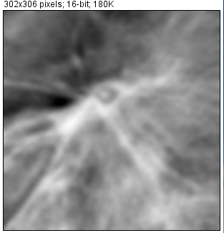
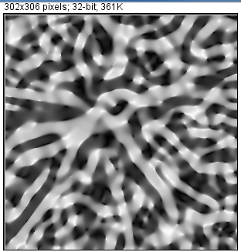
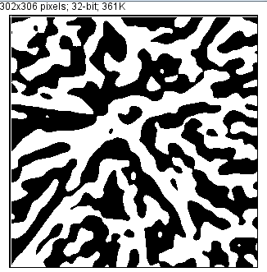
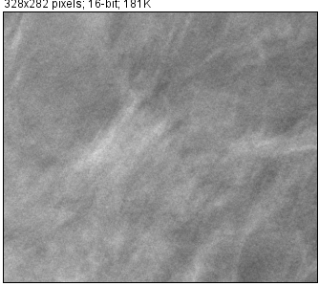
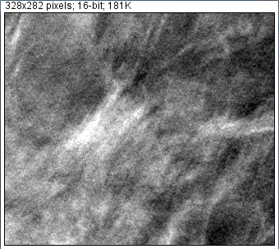
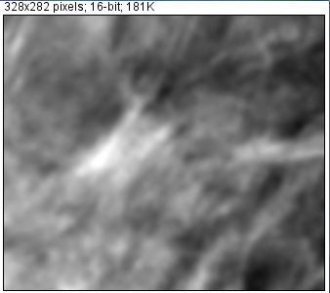
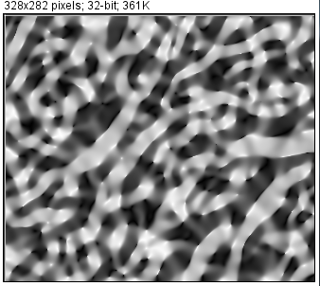
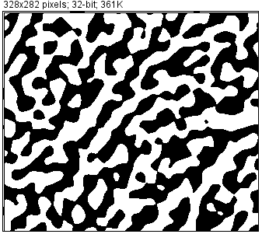
Toy Demo
Spiculated spot vs Random spot
Local contrast enhancement
Smoothing
Shape index mapping
Binarization

Slide 15
Tips
Might be useful ☺
8 bit vs 16 bit
Suspicious exist >4/5 slices
Asymmetry helps only if two image sets are comparable
Typical size: 3~25 mm( spiculated mass)
100 micron * 100 micron/pixel

Slide 16

Where are we standing?
Aichi Triennale 2013 10. August – 27. October 2013

Slide 17
References
[1] Kenji Suzuki, Machine Learning in Computer Aided Diagnosis, Medical Information Science References, 2011.
[2] http://en.wikipedia.org/wiki/Mammography
[3] http://en.wikipedia.org/wiki/Tomosynthesis
[4] The ACR (American College of Radiology) Breast Imaging Reporting and Data System(BI-RADS®) suggests a standardized method for breast imaging reporting.
[5] M.P. Sampat, G.J. Whitman, M.K. Markey, A.C. Bovik: "Evidence Based Detection of Spiculated Masses and Architectural Distortion" in: J.M. Fitzpatrick, J.M. Reinhardt (Eds.), Proceedings of SPIE Medical Imaging 2005: Image Processing, Vol. 5747, San Diego, CA, 2005, pp. 26-37

